Slide 1
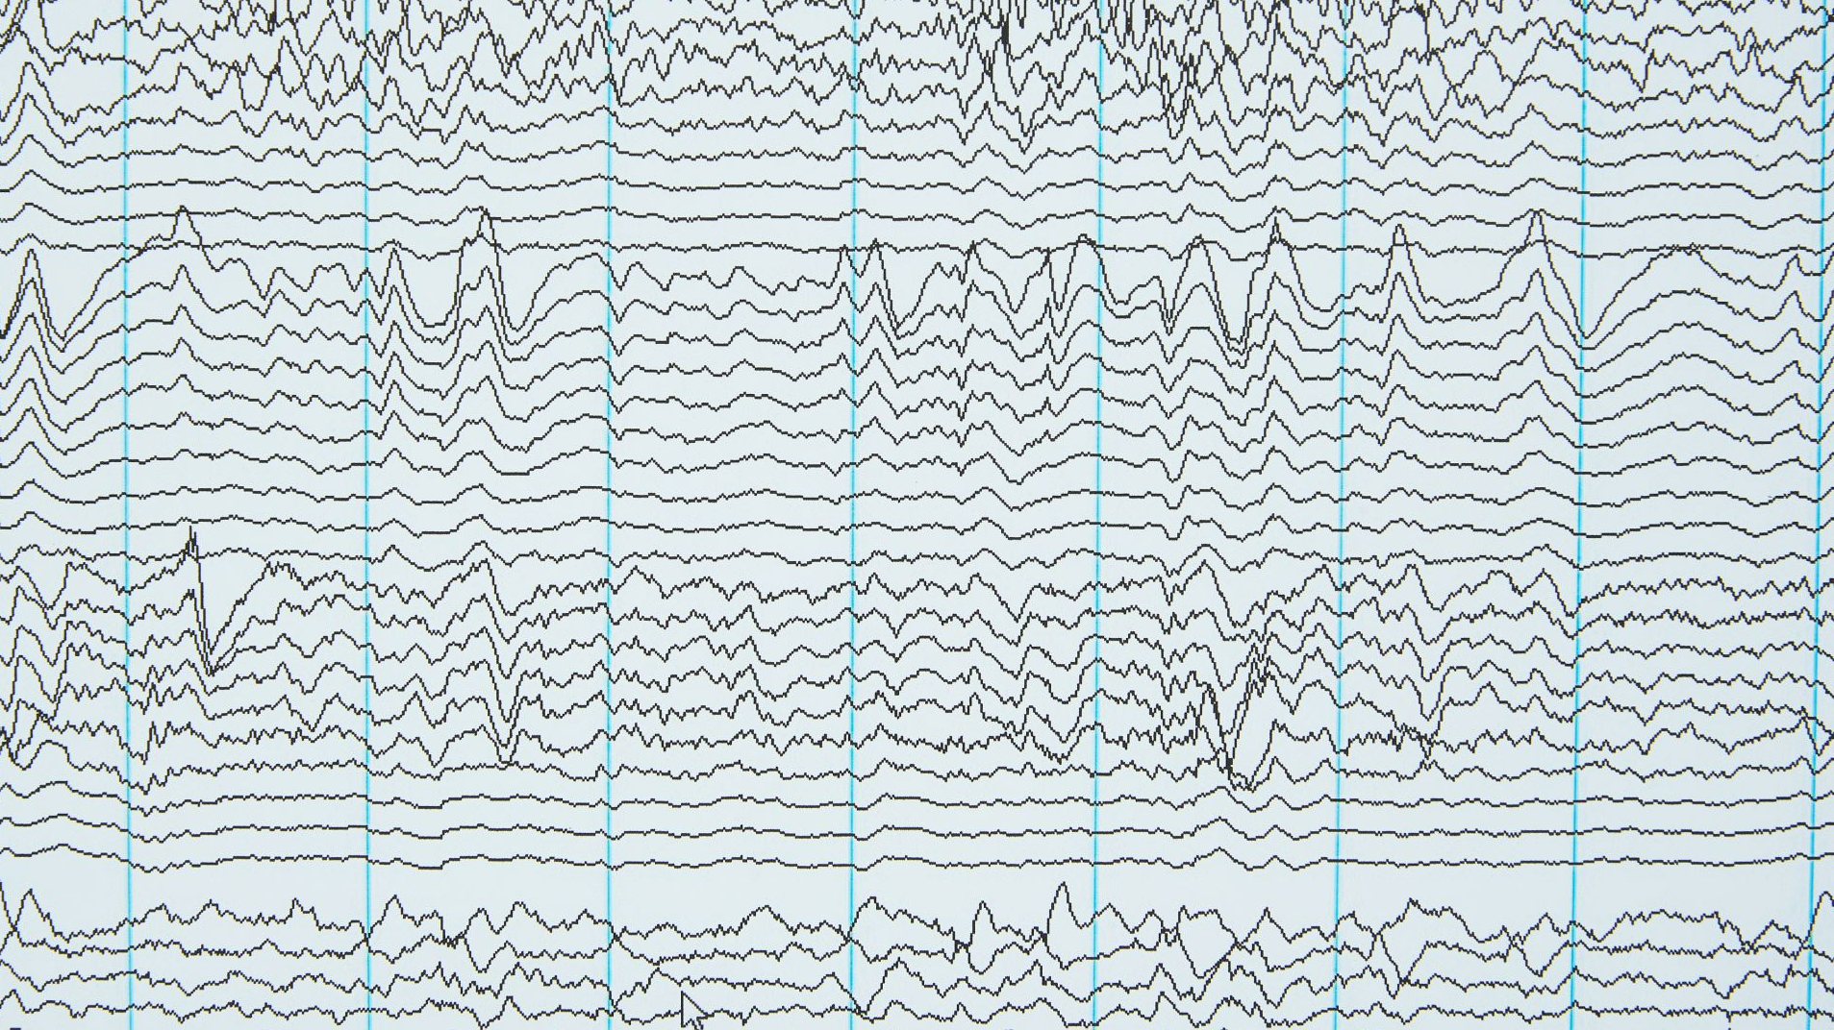
Detection of Adventitious Lung Sounds
By: Maximilian Kobiesa & Sarah Salarda

Slide 2

What are adventitious sounds?
Abnormal breath sounds during respiration.
Often linked to airway obstruction, inflammation, or fluid.
Automated detection improves screening accuracy and consistency.
Table 1. Current lung sound definitions and characteristics.
Sound Types | Key Features | Frequency (Hz) | Duration (ms)
Vesicular | Normal low-pass noise | 100-1000 | -
Pleural Rub | Rhythmic, coarse |  | 15
Crackles | Abrupt, non-musical | ~350-650 | 5-15
Rhonchi | Low-pitched, wheeze | ~150 | 80
Wheezes | Musical, continuous | 100-5000 | 80
Bronchial | Strong respiratory component

Slide 3

How are they currently diagnosed?
Currently requires trained professional (physician) to manually listen to lung sounds, typically using a stethoscope
Typically performed using a stethoscope during physical exams.
Purely qualitative diagnosis process.
Subtle adventitious sounds can be missed or misclassified.

Slide 4
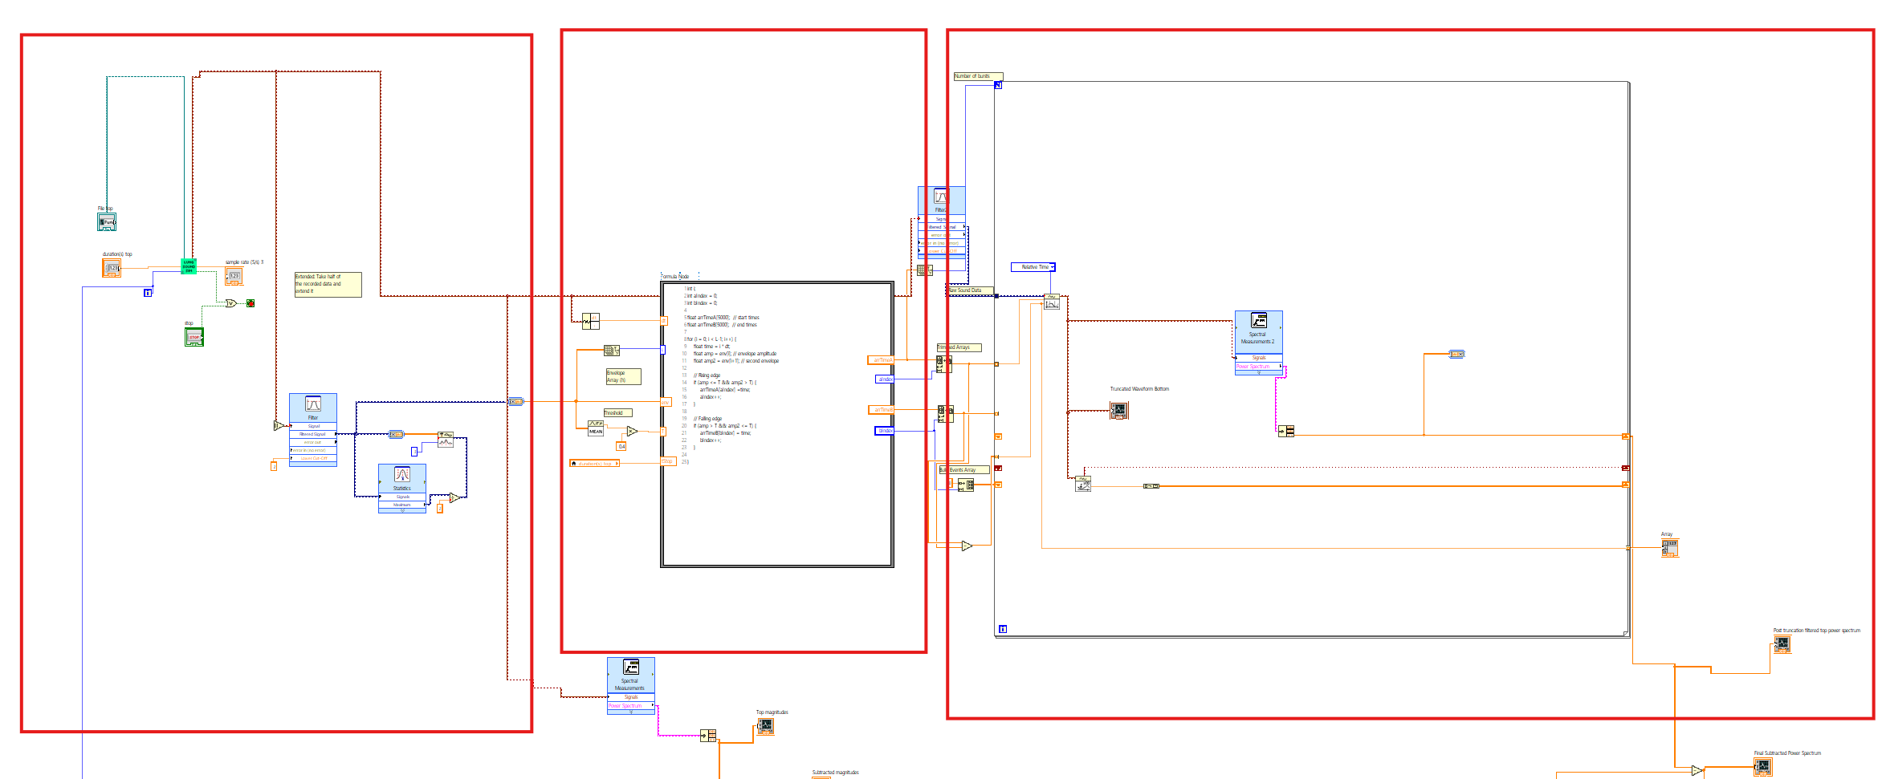
Our solution
Part 1
Part 2
Part 3
Three part VI:
Lab 07
Waveform envelope truncation
Frequency analysis
Allows us to find differences in abundance of specific frequencies we can associate with adventitious sounds

Slide 5
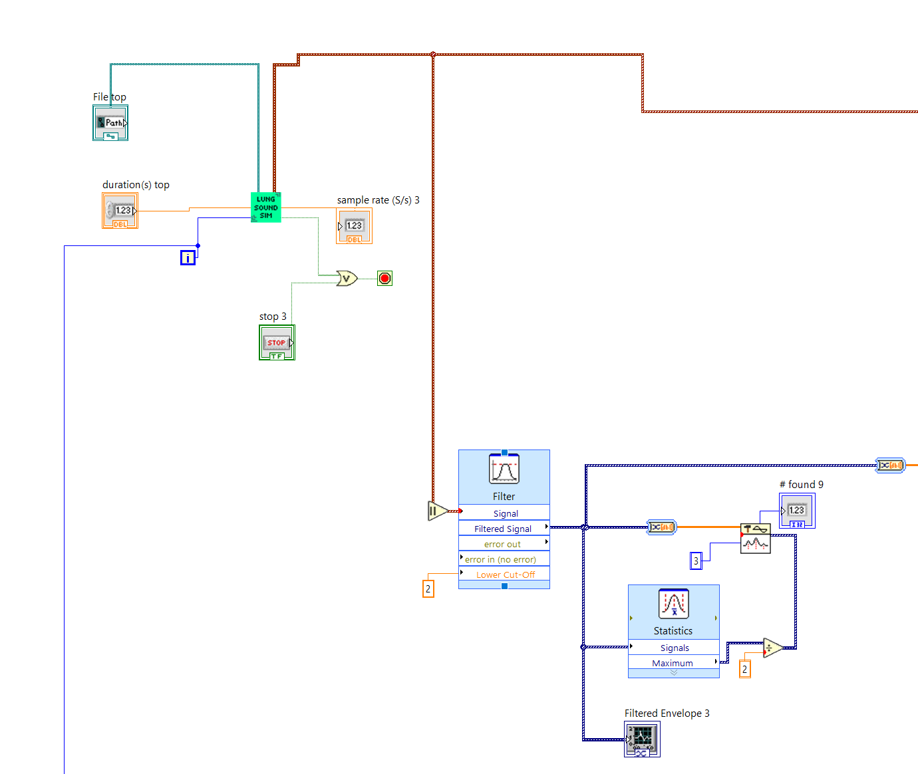
Part 1: Lab 07
Review
Lung Sound Sim:
Sub VI that loads a .wav file and outputs the raw waveform segment for signal analysis.
Envelope Waveform Graph:
Focuses on amplitude changes in the raw waveform segment.
Applies a filter to smooth the envelope to better see "events" of "bursts".
Visualize breath cycles and detect abnormal events in the signal.

Slide 6
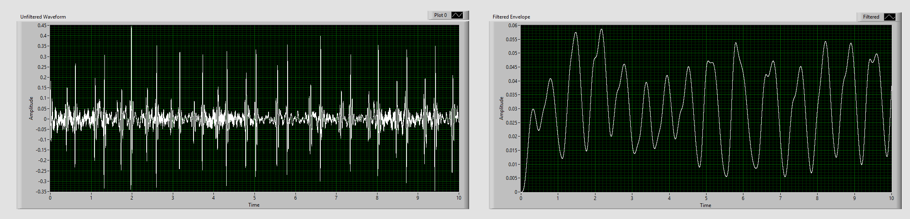
Part 2: Pulling Inhalation and Exhalation Events
Raw lung audio contains long stretches of baseline noise not relevant to breathing.
Truncating specific events focuses the detector on inhalation and exhalation activity.
Helps reduce noise and prevents false detection.
Thresholding
A horizontal threshold represents the minimum amplitude for breathing events.
When the envelope rises above the threshold → start of an event
When the envelope falls below the threshold → end of an event
Threshold
Notes:
Why not STFT?
Truncates based off a set window and not based on whether its significant or not.
Uses a sliding window with a specific length.

Slide 7
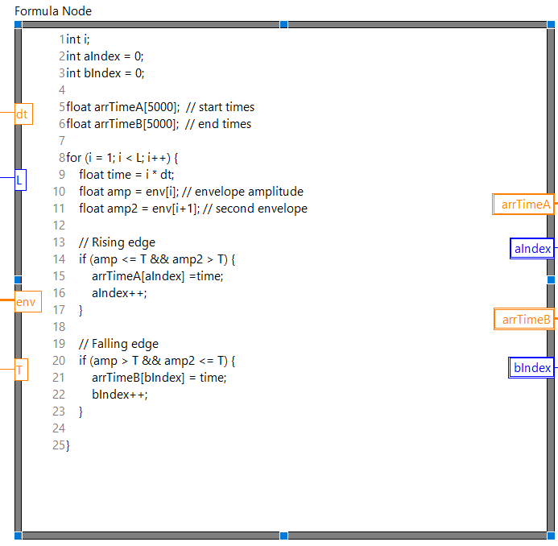
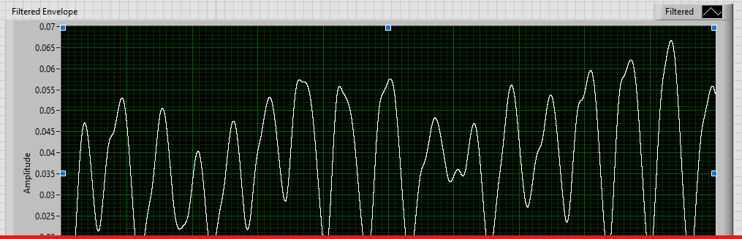
Part 2: Formula Node
Determines start and end times for events within the envelope.
Finds the total duration of "burst" events.
Input:
Time step (dt)
Waveform sample length (L)
Envelope waveform amplitude (env)
Threshold (T) = mean of waveform x 0.4
Output:
Start time array (arrTimeA)
End time array (arrTimeB)
Sample index (aIndex and bIndex)

Slide 8
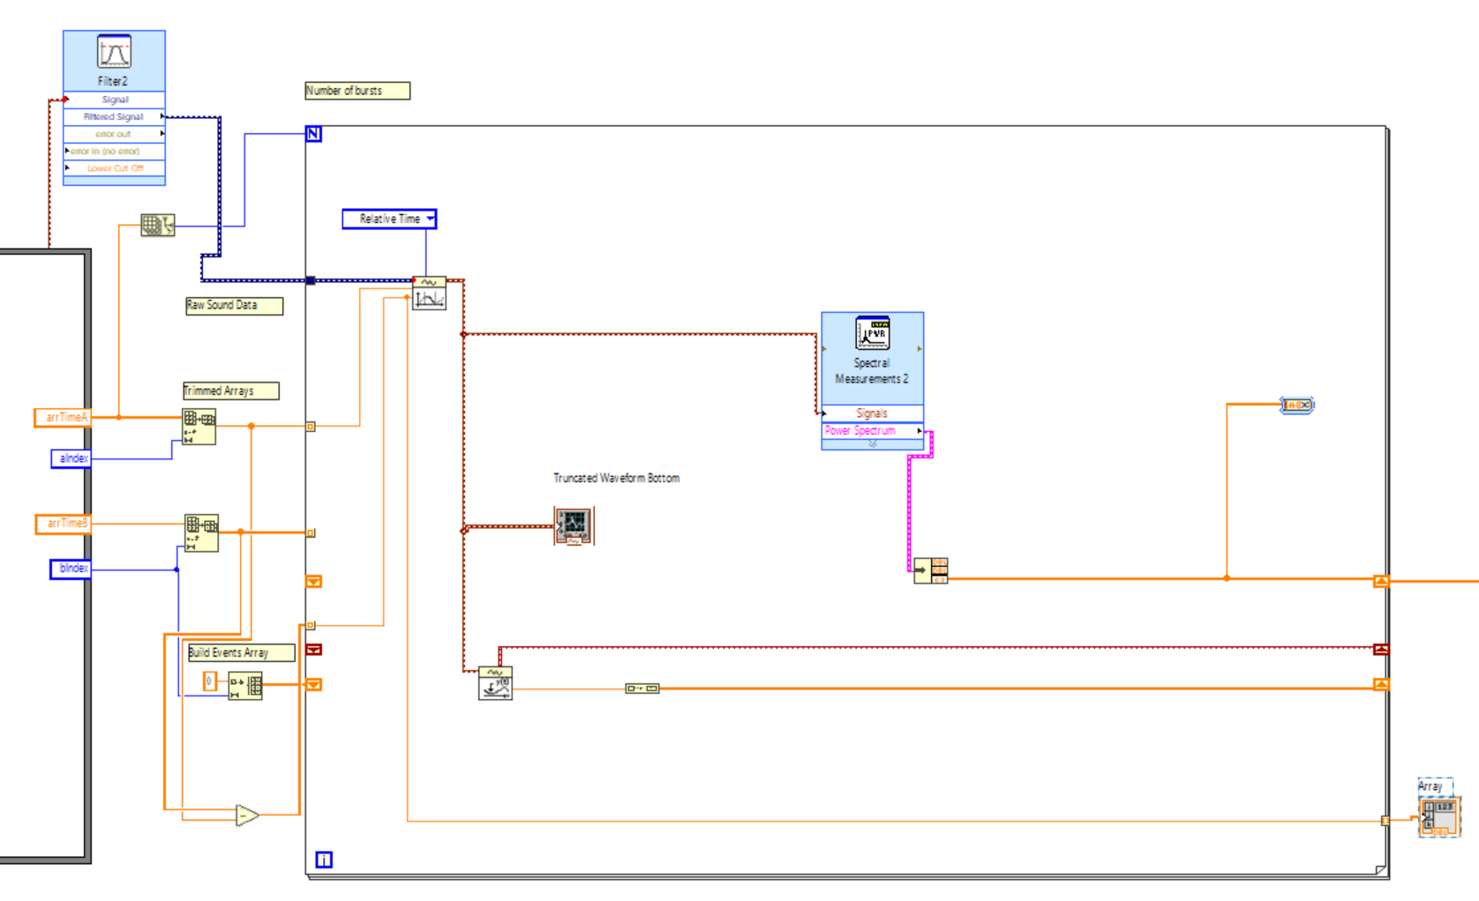
Part 3: For Loop Analysis of each "Burst"
Segments the raw sound waveform based off the starting time and burst's duration (Get Waveform Subset VI).
Number of bursts (N)
Sample index (i)
Can do an analysis for each burst.

Slide 9
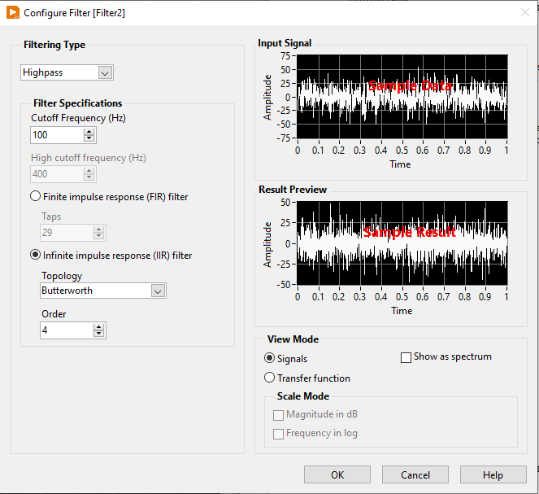
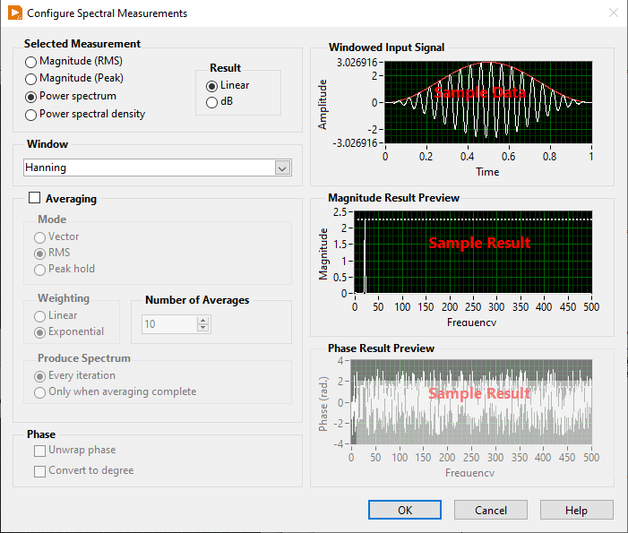
Part 3: Power Spectrum Analysis
High Pass Filter
Fourier Transform and Power Spectrum
Notes:
Why not a STFT here?

Slide 10
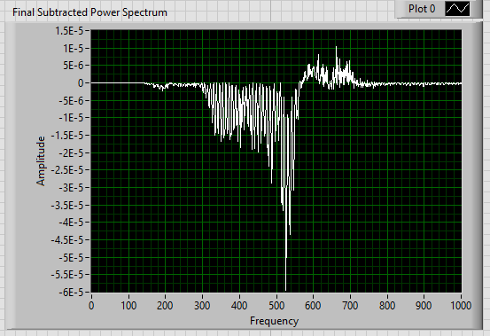
Results
Subtracted weighted frequencies
Allows us to identify frequencies present in one case compared to another
Allows us to eliminate redundant frequencies present in healthy and diseased lung sounds

